Slide 1
SECURE DATA HIDING IN IMAGES USING STEGANOGRAPHY
CAPSTONE PROJECT
Presented By: Akhilesh Badrinath
Student Name : Akhilesh Badrinath
College Name & Department : SIES Graduate school of Technology, Nerul (E)
Department of Computer Engineering

Slide 2
OUTLINE
Problem Statement
Technology used
Wow factor
End users
Result
Conclusion
Git-hub Link
Future scope

Slide 3
Problem Statement
In today’s generation where digital communication privacy is increasingly important, we need secure and reliable methods to transmit confidential messages. Steganography is the practice of concealing information within seemingly innocent carriers like images, videos, audios etc. which offers solution by hiding messages within digital images etc without visibly altering their appearance.

Slide 4
Technology used
Programming Language: Python (Python IDLE 3.12)
Required Libraries:
OpenCV (cv2)
NumPy
Hashlib
OS
String
Input/Output: Command-line interface

Slide 5
Wow factors
Message Hiding
User can hide confidential messages in images along with passwords and pass it seamlessly
Message Retrieval
Once the recipient receives the images encrypted with the image, he can decrypt it and read the secret message after providing a passcode
Unauthorized Access Prevention
If an unauthorized person attempts to extract message, by providing incorrect passwords, the system denies them access, hence achieving the Security goal of confidentiality

Slide 6
End users
1. Privacy-Conscious Individuals
2. Security Professionals
Cybersecurity experts testing secure communication methods
IT professionals implementing secure data transfer solutions
3. Educational Sector
Computer science students learning about cryptography
4. Detectives who want to pass on secret messages through innocent ways.

Slide 7
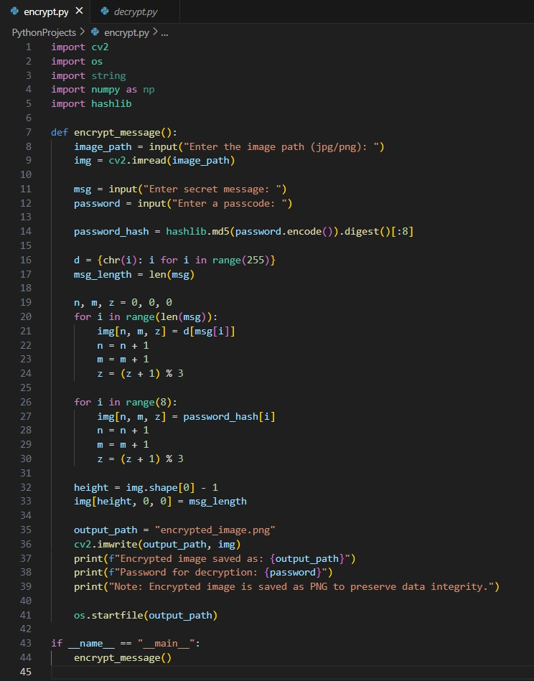
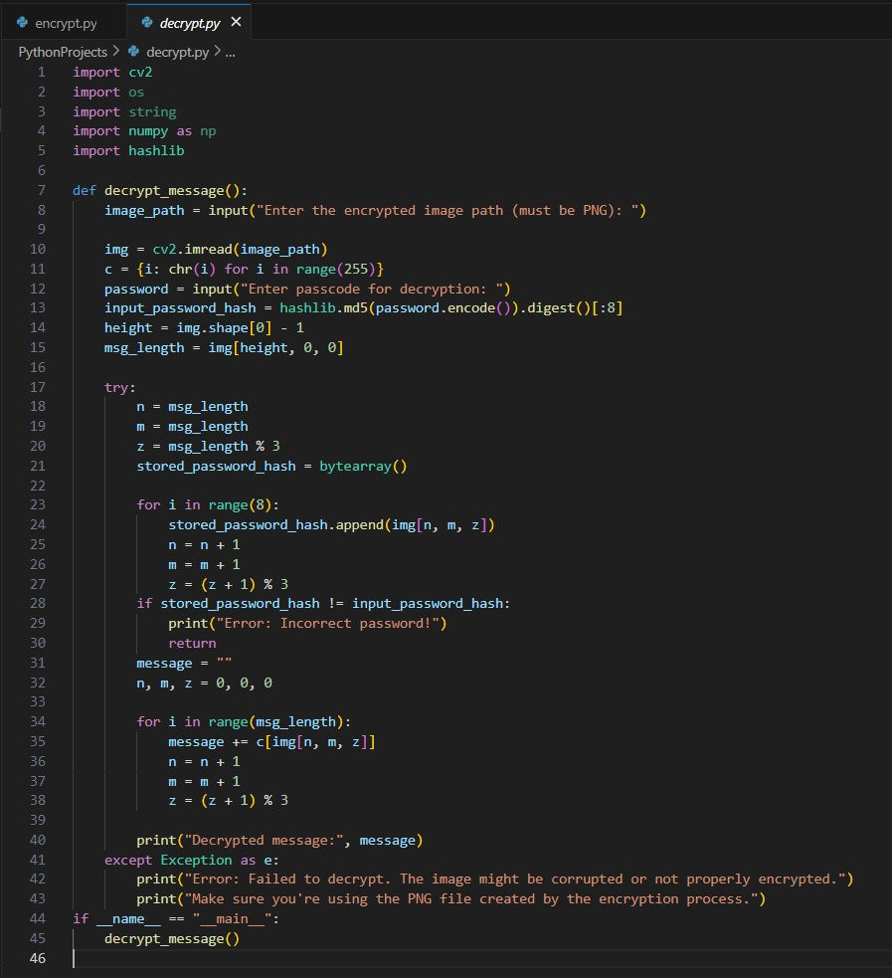
Results

Slide 8
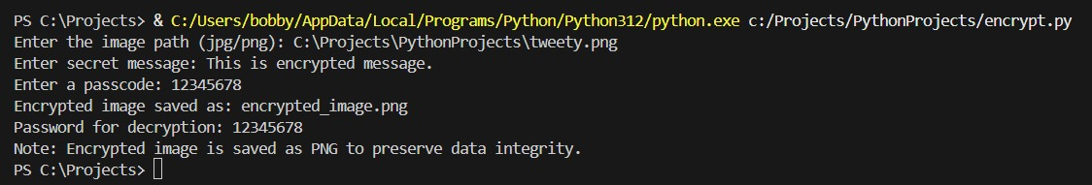
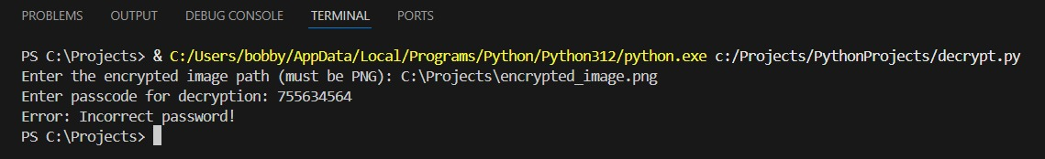
Results
Checked for Correct and Incorrect Values of passcode

Slide 9
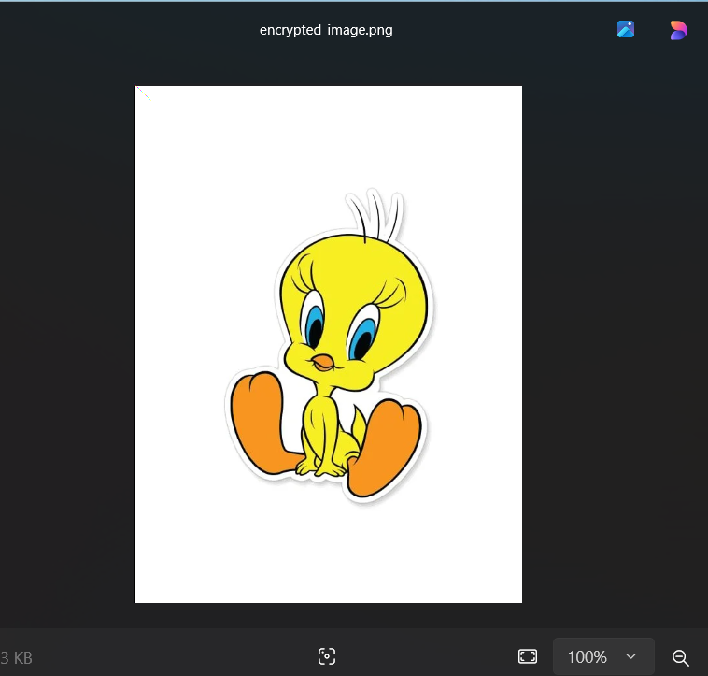
Results
The Encrypted Image

Slide 10
Conclusion
The implemented image steganography system successfully addresses the growing need for secure and private digital communication.
By leveraging the principles of digital image processing and cryptography, the system provides a robust solution for hiding confidential messages within ordinary image files while ensuring data security through password protection.

Slide 11
GitHub Link
https://axasia11.github.io/AICTE-Cybersecurity-Internship/

Slide 12
Future scope(optional)
Graphical user interface development
Integration with existing communication systems
Enhanced encryption algorithms
Batch processing capabilities
Support for additional file formats
Innovative structures for System Security

Slide 13
THANK YOU

